Slide 1
LC Training for RDA: Resource Description & Access
Authorities Day 1
Cooperative and Instructional Programs Division
Library of Congress, 2012
Adapted for UC San Diego Catalogers
Presented February 19, 2013
by Ryan Finnerty at UC San Diego

Slide 2
LC Training for RDA: Resource Description & Access
Part 1: FRBR/FRAD Review

Slide 3
The Realities
PCC RDA policies are in flux
LC first published its own set of Policy Statements
PCC and LC are trying to harmonize policy
Things– not just policies-- are changing by the minute
You need to monitor PCC RDA activities via PCC lists or the PCC website
Flexibility is essential
3
Notes:
3

Slide 4
FRBR
Foundation of RDA
RDA used FRBR vocabulary where appropriate

Slide 5
FRBR Group 1 Entities
Work
is realized through
Expression
Intellectual/Artistic Content
is embodied in
Physical – Recording of Content
Manifestation
one
is exemplified by
many
Item
Notes:
5
These four entities in Group 1 are the product of intellectual and/or artistic endeavor – the content and the packages that contain that content – all of the bibliographic resources that we want to make available to our users – the things libraries collect or provide access to. The model calls these work, expression, manifestation, and item. The entities form a hierarchy with work at the top of the model so it may help to see them in a diagram as here.
This diagram begins to show how the Group 1 entities are related to each other.
When we create a bibliographic record, most of it relates to the manifestation, but we are “cataloging” the whole package when we add access points and create authority records.

Slide 6
FRBR Group 2/FRAD
Work
Expression
one
Manifestation
many
Item
is owned by
is produced by
Person
is realized by
Family
is created by
Corporate Body
Notes:
6
6
Within the FRBR are the G2 entities with which a G1 entity can be related. All the G2 entities are people-based entities that DO things to the G1 entities.
Let’s now move on to relationships for the Group 2 entities: person, family, and corporate body.
You see the relationships with the Group 1 entities in this picture: Work is created by a person, family, or corporate body Expression is realized by a person, family, or corporate body Manifestation is produced by a person, family, or corporate body Item is owned by a person, family, or corporate body.
The names of these Group 2 entities are controlled when they are used as access points in bibliographic records.

Slide 7
FRAD
Functional Requirements for Authority Data
User tasks
Find: Find an entity or set of entities corresponding to stated criteria
Identify: Identify an entity
Clarify (Justify): Document the authority record creator’s reason for choosing the name or form of name on which an access point is based.
Contextualize (Understand): Place a person, corporate body, work, etc. in context
Example: WorldCat Identities: http://worldcat.org/identities/
Notes:
For those FRAD entities, we have a slightly different set of user tasks.
All of those tasks serve to ultimately establish the authorized form, in order to link that G2 entity to a G1 entity in some way.
7

Slide 8
FRBR → FRAD
Corporate Body
Schott
Person
Wagner, Richard, 1813-1883
Publishes
Family
Smythe
Is published by
Created by
Creates
Manifestation
Die Meistersinger von Nürnberg
Is given by
Gives
Work
Die Meistersinger von Nürnberg
Item
Die Meistersinger von Nürnberg
8
Notes:
FRBR - Tillett presentation, March 4, 2009
8
8
8
Which brings us to the relationships. All kinds of relationships.
Here we have one work with multiple relationships, at multiple levels of the WEMI structure. Work to Manifestation, Work to Person, Expression to Corporate Body, Family to Item, etc.
In fact, I think it’s safe to say that we are an absolute mass of relationships, and catalogers can only express so many of them.

Slide 9
FRAD : Group 2 Entities
Persons, corporate bodies, and families responsible for
the intellectual or artistic content,
the physical production and dissemination, or
the custodianship of the entities
Notes:
So we pick and choose which relationships to describe.
Looking at the FRBR model, we can see that there are relationships between works and creators that we can capture in bibliographic terms. We give the authorized form of name of a creator as access, and often we describe the creator in the statement of responsibility.
We do not provide other identifying characteristics/attributes of “persons” or other entities that can be creators in the bibliographic data -- they are described in Authority data. FRBR refers to persons and corporate bodies responsible for works as “Group 2 Entities.”
9

Slide 10
FRAD : Attributes
Attributes of a person
Title of person
Dates associated with the person (birth/death/period of activity)
Gender
Place of birth
Place of death
Country
Place of residence
Affiliation
Address
Language of person
Field of activity
Profession / occupation
Biography / history
Other informational elements associated with the person
Notes:
So when describing those entities in order to establish the unique form of authorized access point, we record a group of attributes that make that entity completely unique.
For people, we have the largest group of attributes.
Just as Group 1 entities have attributes, Group 2 entities have their own set of attributes.
10

Slide 11
FRAD : Attributes
Attributes of a family:
Type of family
Dates of family
Places associated with family
Field of activity
History of family
Notes:
Families, our newest entity, also has a list of attributes.
The important thing to note here is that we are not talking about family names throughout the entire history of that family name. We are talking about a limited grouping of that family name, usually limited by date and/or place.
But this concept is no different than that for persons and corporate bodies. “Smith, John” isn’t used to represent all “John Smiths” any more than “Smith Family” is used to represent all Smith families. With persons, we describe a specific person; with families we describe a specific family.
Please remember, though, that family names for subject access should still be established in the LC/SACO Authority File following the provisions in the Subject Headings Manual H 1631.
11

Slide 12
FRAD : Attributes
Attributes of a corporate body
Place associated
Dates associated
Language of the corporate body
Address
Field of activity
History
Other information associated with the corporate body
Notes:
And corporate bodies have attributes as well, reflecting its life over time.
Please note: for the purposes of name authority work, we are considering geographic names for political jurisdictions as a type of corporate body, since they are functioning in that manner in the bibliographic access points (1XX and 7XX).
12

Slide 13
FRAD : Entities
Work:
Title of Work
Form of Work
Date of Work
Place of Origin of Work
Other Distinguishing
Characteristic of Work
History of the Work
Identifier for the Work
Expressions:
Content Type
Date of Expression
Language of Expression
Other Distinguishing Characteristic of Expression
Identifier for the Expression
Notes:
Works and expressions can get authority records, so we’ll be talking about them again in the authorities section of the training.
Here are their attributes.

Slide 14
FRBR/FRAD
Authority work, just like bibliographic work, is fundamentally influenced by the FRBR and FRAD models
Notes:
The important thing to understand is that the authority work, just like bibliographic work, is fundamentally influenced by the FRBR models, which influences what we record in order to serve the purpose of the unique, authorized access point that we are trying to establish.

Slide 15
LC Training for RDA: Resource Description & Access
Part 2: RDA Documentation

Slide 16
PCC RDA NACO “Policy” vs. “Best Practice”
“Policy” still under development
“Best practice” used in many cases until policy is determined
However, in many cases, we have not had enough practice yet to determine what is best
16
Notes:
We are in a transition period.
All catalogers need to be aware that in many cases there is no concrete PCC “policy” for many issues. PCC policies are still being determined.
Yet we do not want to hold back on training until all the PCC policies are in place. That would be a disservice to all PCC members.
So you need to understand that in many cases, we will allude to PCC “best practice” as an interim practice until PCC policy is firmly in place.
Please be sure that you are aware of the differences between “policy” and “best practice.”

Slide 17
Authority Documentation: Where is it?
RDA Toolkit
LC-PCC PS’s
MARC 21 Authority Format
DCM Z1 and the LC Guidelines
PCC Web Site
PSD Web Site
NACO RDA Participants’ Manual – Coming soon
17
Notes:
RDA NACO documentation is in the same locations as AACR2 NACO documentation, so you do not necessarily need to learn about new sources to find documentation, but of course, the documentation itself will be different.
Also, because RDA is a new cataloging code and is evolving, RDA NACO documentation is not as stable as AACR2 NACO documentation. That means that you must stay current– things are in flux and will continue that way for a while. So flexibility is essential. Look it up!
In addition to NACO documentation, please do not forget that there are many helpful PowerPoint presentations available. Supplementary materials such as these often end up being “hidden away” when it is not spelled out anywhere else.
The NACO RDA Participant’s Manual should be coming soon.

Slide 18
RDA Toolkit http://access.rdatoolkit.org/
18
Notes:
The RDA Toolkit is the primary source for RDA NACO documentation, just as AACR2 is for AACR2 NACO documentation.

Slide 19
RDA Toolkit desktop.loc.gov
19
Notes:
The RDA Toolkit is also available in Cataloger’s Desktop (desktop.loc.gov)
Can also get to it from the main page of TPOT

Slide 20
RDA Toolkit Help!
http://access.rdatoolkit.org/help.php
20
Notes:
The RDA Toolkit has its own Help page, which will guide you through creating profiles and navigation. And much much more.
Remember, this module of NACO RDA training does not go into the details of where to find instructions that you need to work with authority headings– that will come when you work take the modules on RDA organization.

Slide 21
RDA Toolkit Help!
21
Notes:
The Catalogers Learning Workshop webpage has an RDA Toolkit guide, too– this guide is very user-friendly and can easily be printed out to keep at your work station as a resource.

Slide 22
LC-PCC PS’s http://access.rdatoolkit.org/
22
Notes:
The LC-PCC PS’s are the local policy guidelines that PCC catalogers use for applying RDA. They correspond to the LCRI’s that you used with AACR2.
The LC-PCC PS’s are in the RDA Toolkit, so you do not need to go beyond this resource to find them.
An interesting note, there are many fewer LC-PCC PS’s than there were LCRI’s– this is intentional, to make cataloging less rule-bound, and to leave more decisions to cataloger judgment.
However, this is an important point– the LC-PCC PS’s are currently in flux as LC and the rest of PCC hammer out what they should be. In some cases you’ll see text like “LC catalogers do this – larger PCC practice still being decided”

Slide 23
LC-PCC PS’s desktop.loc.gov
23
Notes:
The LC-PCC PS’s are also available in Catalogers Desktop.

Slide 24
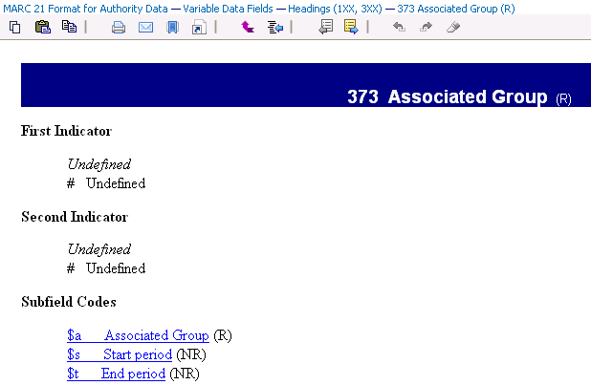
MARC 21 Authority Format desktop.loc.gov
24
Notes:
Just as with AACR2, you need to use the MARC 21 Authority Format as the start for NACO RDA policy on MARC coding, etc.
And just as with AACR2, you will also need to go to the LC/PCC Guidelines and to DCM Z1 for further clarification on what you find in the MARC 21 Authority Format. So this is nothing new.
The MARC 21 Authority Format is in Catalogers Desktop, and there still are links to the LC/PCC Guidelines and to DCM Z1.
However, again, please be aware that the LC/PCC Guidelines and DCM Z1 will be undergoing updates as RDA implementation and related activities dictate.
You need to be vigilant in checking for the latest documentation.

Slide 25
MARC 21 Authority Format http://www.loc.gov/marc/authority/
25
Notes:
Another source for MARC 21 Authority Format data– but no links to NACO rules, so not the preferred mode of access.

Slide 26
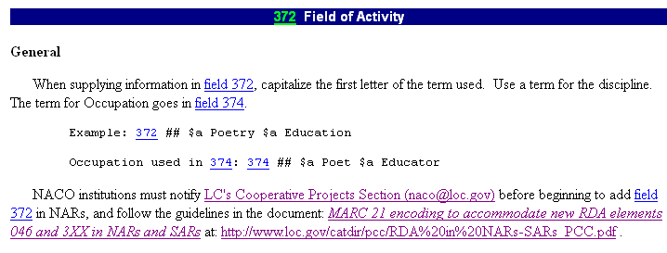
DCM Z1 and the LC Guidelines desktop.loc.gov
26
Notes:
We continue to use the Descriptive Cataloging Manual Z1 and the LC Guidelines, just as we did for AACR2 NACO cataloging.
DCM Z1 and the LC Guidelines are not available in the RDA Toolkit, but they are available on Catalogers Desktop, the preferred mode of access.

Slide 27
PCC web site http://www.loc.gov/aba/pcc/
27
Notes:
Even the PCC website is in flux!
The new site was released in April 2012.
Because of the period of transition to RDA and the large amount of changes that will be taking place in the PCC community, you must consult the PCC site and the PSD site to keep abreast of the latest news and documentation.
Some NACO documentation that you traditionally would find on the PCC web site still is there– the NACO Normalization Guidelines, for example, and the NACO FAQs. These are on the next slide.

Slide 28
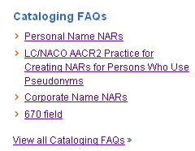
PCC web site http://www.loc.gov/aba/pcc/
28
Notes:
Here are the NACO Normalization Guidelines and the NACO FAQs.

Slide 29
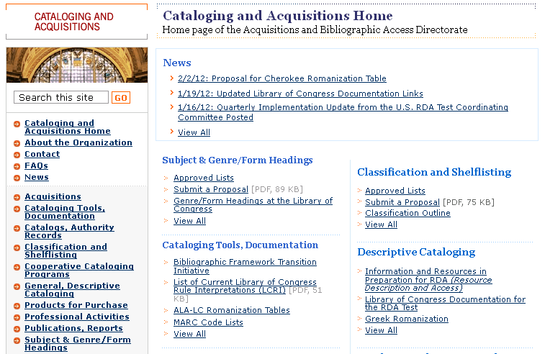
PSD web site http://www.loc.gov/aba
29
Notes:
And here is the PSD (Policy and Standards) website.
One piece of NACO documentation that you will find here is the ALA-LC Romanization Tables, but there also is a wealth of PCC policy news, white papers on various topics of interest to NACO, and news on subject-related issued that affect NACO work.

Slide 30
Summary
Some authority rules are changing under RDA
Most of them are the same as under AACR2
RDA authority documentation is found in the same locations as AACR2 authority documentation
Flexibility is critical during the RDA transition phase
30
Notes:
RDA NACO documentation is in the same locations as AACR2 NACO documentation, so you do not necessarily need to learn about new sources to find documentation, but of course, the documentation itself will be different.
Also, because RDA is a new cataloging code and is evolving, RDA NACO documentation is not as stable as AACR2 NACO documentation.
That means that you must stay current– things are in flux and will continue that way for a while. So flexibility is essential.

Slide 31
LC Training for RDA: Resource Description & Access
Part 3: RDA in MARC 21

Slide 32
RDA authority record in MARC
008/10 (OCLC: Rules) = z for Other
040 $e rda
These two codings go together, as the z indicates “Other” for the source of the descriptive cataloging rules being used and the 040 $e tells us which rules are being used.

Slide 33
Old fields still in use without change
670 for information found
Some of what used to be recorded here can now be recorded in other fields, but the fundamental function of the 670 – to record Information found – has not changed
675 for information not found
663 for multiple pseudonym situations

Slide 34
Old fields in use with minor changes
1XX
4XX
5XX
667
678

Slide 35
What changes? 1XX, 4XX, 5XX
100, 400, 500 fields
The $c subfield may occur in front of the $q subfield. Jones, J. $c Jr. $q (John)
RDA 9.19.1.1 tells us to select the attributes in the order presented in 9.19.1.2-.7
$c Title, $d Dates, $q Fuller Form, $d Period of Activity, $c Profession or Occupation [MARC order will be different!]
So it is possible to have multiple $c subfields, or $c in front of $q or $d
Notes:
Terms of relationship are now integral parts of the name, not additions, so they go before any additions
35

Slide 36
What changes? 5XX
5XX
Possible to use relationship designators from Appendix K to indicate relationships between NAR’s
$w r with related $i (or $4) for use with (e.g.):
Predecessor/Successor for corporate bodies
Progenitor/Family member for Families and Personal Names
This is an area that will be elaborated over time.
Notes:
Please note that all the relationships expressed in App. K are available for use
$i must be used with $w r. Otherwise the MARC coding will not be happy.
Please note, these fields are not required to be reciprocal. All relationships are reciprocal– it is just that we are not requiring that the relationship be expressed in both the records– i.e., we do not have to have a reciprocal 5XX in the “other” record. That is a policy issue, not the nature of a relationship.
NOTE: the $4 is the coded form of what is written out in $i. We won’t be using $4.
36

Slide 37
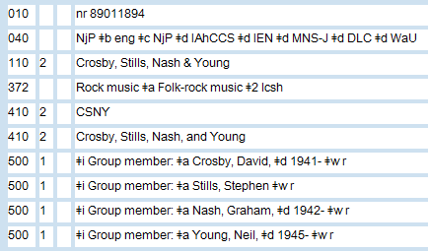
What changes? 5XX
Notes:
Example of reciprocal relationship designators

Slide 38
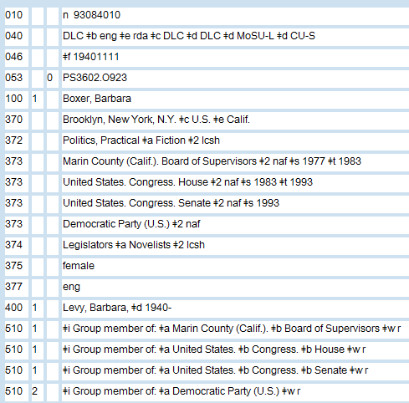
What changes? 5XX
Notes:
Note that these relationship designators are not always reciprocal (nor should they be—use judgment)

Slide 39
What changes? 667
Transition from AACR2 to RDA will entail some changes that require human intervention
A note will be placed in the 667 which will notate these authority records
What do you do when you see them? If you are independent, update the record
Guidelines will be provided
Notes:
The 667 has always been a workhorse field, which hasn’t changed. Watch for it carefully, as it will continue to be an all-purpose workhorse field that will inform you of important things.
Text of note reads, “THIS 1XX FIELD CANNOT BE USED UNDER RDA UNTIL THIS RECORD HAS BEEN REVIEWED AND/OR UPDATED.”
39

Slide 40
What changes? 678
Formerly abandoned with AACR2, now returning to life
Meant for the public to see more than for the cataloger, so write them coherently, not in the shortest form possible
Example:
678 Roy Harvey Pearce (1919-2012), one of the founders of the UC San Diego Literature Department, was a renowned scholar of American Literature.
Notes:
The 678 field, defined in the MARC 21 Authority Format as “Biographical or Historical Data” is an old field that is coming back to life.
40

Slide 41
What are the new fields?
046
336
368
370
371
372
373
374
375
376
377
378
380
381
382
383
384
Notes:
These are not dependent on or specific to a cataloging code. You can add them to any already created AACR2 record, not just RDA records.
As long as the 008/10 & 040 $e rda fields are in and the 1XX is formulated according to RDA, you could use none of these fields and still have an RDA authority record.
41

Slide 42
Fields related to Entity Attributes
All authority records
046
370
371
372
373
377
Personal Names Only
374
375
378
Corporate Bodies Only
368
Family Names Only
376
Works, Expressions, Only
336, 380, 381
Music Only
382, 383, 384
Notes:
42
We’ll be going over each fields in a bit more detail next.
However, there is a change which I want you all to note; the 368 field can also be used for persons. This is where you record “Saint” “Spirit” or royal/noble/religious titles for a person.

Slide 43
MARC 21 in RDA Authority Records
Fields for all Authority Records

Slide 44
New field: 046: Special Coded Dates (R)
No indicators
Subfields:
$f - Birth date (NR)
$g - Death date (NR)
$k - Beginning or single date created (NR)
$l - Ending date created (NR)
$s - Start period (NR)
$t - End period (NR)
$u - Uniform Resource Identifier (R)
$v - Source of information (R)
$2 - Source of date scheme (NR)
RDA 9.3, 10.4, 11.4, 6.4, 6.10
Notes:
Good to note that this is the only one that does NOT define $a or $b subfields.
$f & $g are used for persons (though s/t can be used for activity dates)
$k & $l are used for works and expressions
$s & $t are used for corporate bodies, including conferences
44

Slide 45
New field: 046: Special Coded Dates (R)
Special code means there is a strict format to follow:
DEFAULT is ISO 8601: YYYYMMDDHHMMSS.S
Unless $2 specifies another encoding scheme for dates
The other standard to be used is the $2 edtf (Extended Date/Time Format) for uncertain dates
Notes:
45
Source list for $2 is available on LC’s website.
Google “LC Date and Time Scheme Source Codes” to find it
This is the URL in case anyone asks: http://www.loc.gov/standards/sourcelist/date-time.html

Slide 46
New field: 046: Special Coded Dates (R)
For a person born in June 2, 1946 and still alive
046 _ _ $f 19460602
For a person born in 1840 and dead at the Battle of Bull Run on July 21, 1861
046 _ _ $f 1840 $g 18610721
Notes:
Note that completeness of the subfields can differ based on the information you have

Slide 47
New field: 370: Associated Place (R)
No indicators
Subfields:
$a Place of birth (NR)
$b Place of death (NR)
$c Associated country (R)
$e Place of residence/headquarters (R)
$f Other associated place (R)
$g Place of origin of work (R)
$s Start period (NR)
$t End period (NR)
$u Uniform Resource Identifier (R)
$v Source of information (R)
$0 Record control number (R)
$2 Source of term (NR)
RDA 9.8, 9.9, 9.10, 9.11; 10.5; 11.3.3, 11.9, 11.3.2; 6.5

Slide 48
New field: 370: Associated Place (R)
If more than one $s start and $t end period related with a particular place, repeat the field, not the subfields
$a and $b are specific to Personal Names
$g is specific to Works
All other subfields are available for all types of NAR’s, as shown in the RDA instruction references.

Slide 49
New field: 370: Associated Place (R)
The form of the name of the place should be in the authorized form, according to RDA
Written as it would be in a qualifier in the 1XX (no parentheses)
Even if it is not established in the NAF yet, record it in that form
No need to establish it
Notes:
If you have to do a whole lot of research to establish what that form is, you should probably establish the place on its own as well.
49

Slide 50
New field: 370: Associated Place (R)
Notes:
50

Slide 51
New field: 371: Address (R)
No indicators
Subfields:
$a Address (R)
$b City (NR)
$c Intermediate jurisdiction (NR)
$d Country (NR)
$e Postal code (NR)
$m Electronic mail address (R)
$s Start period (NR)
$t End period (NR)
$u Uniform Resource Identifier (R)
$v Source of information (R)
$z Public note (R)
$4 Relator code (R)
RDA 9.12; 11.9

Slide 52
New field: 371: Address (R)
Available for Personal Names and Corporate Bodies
Privacy issues?
Notes:
Multiple addresses need to end up in separate fields, even if the subfields are repeatable.
NOTE: there is a difference between the 370 and the 371. The 370 (Associated place) is an association at the level of country, town, but not to the level of street name. The 371 (address) is the specific address at which someone can receive mail.
For persons, just record the email address
52

Slide 53
New field: 373: Associated Group (R)
No indicators
Subfields:
$a Associated Group (R)
$s Start period (NR)
$t End period (NR)
$u Uniform Resource Identifier (R)
$v Source of information (R)
$0 Record control number (R)
$2 Source of term (NR)
RDA 9.13; 11.5
Notes:
53
Used for both persons and corporate bodies

Slide 54
New field: 373: Associated Group (R)
Formerly called Affiliation
Expresses a relationship between 1XX and a group
Use the NAF form (if available) with “$2 naf”
Notes:
54

Slide 55
New field: 377: Associated Language (R)
Second indicator “7” if using a specific source, which would then be noted in the $2
If using the MARC Code List, second indicator is blank
Subfields:
$a Language code (R)
$l Language term (R)
$2 Source of code (NR)
RDA 9.14; 11.8

Slide 56
New field: 377: Associated Language (R)
Use an authorized code from the MARC Code List for Languages
Record the language the person/family/corporate body uses in works it creates or contributes to
e.g. a writer who is a native English speaker but publishes exclusively in German – record “ger” for German
NOTE: although RDA does not specify the language attribute for Family names, the MARC Authority Format allows you to record the language of the family
Notes:
56
ABBA would be an example here. They were Swedish and wrote songs to be sung in English.
However, for creators of non-language works, the language should not be recorded

Slide 57
MARC21 in NACO RDA Authority Records
Personal Names

Slide 58
New field: 372: Field of Activity (R)
No indicators
Subfields:
$a Field of activity (R)
$s Start period (NR)
$t End period (NR)
$u Uniform Resource Identifier (R)
$v Source of information (R)
$0 Record control number (R)
$2 Source of term (NR)
RDA 9.15; 11.10

Slide 59
New field: 372: Field of Activity (R)
Examples:
Jazz vs. jazz musician
Yoga vs. yogi
Astrophysics vs. physics professor
Education vs. teacher
Knitting vs. knitter
Local history vs. historian

Slide 60
New field: 374: Occupation (R)
No indicators
Subfields:
$a Occupation (R)
$s Start period (NR)
$t End period (NR)
$u Uniform Resource Identifier (R)
$v Source of information (R)
$0 Record control number (R)
$2 Source of term (NR)
RDA 9.16

Slide 61
New field: 374: Occupation (R)
Capitalize the first word of the occupation
Generally this means what a person is paid to do (though some interpret more liberally)
May use an LCSH term – but LCSH terms are generally plural for “classes of persons”; this is NOT PRESCRIPTIVE; if you do use LCSH vocabulary, code $2 lcsh
Notes:
61
How do you describe that person’s occupation? Well, you may be the one to decide. For example, do you call someone a writer or a journalist? How is the person presented to you?
LC now prefers controlled vocabulary
Field recently expanded to also include avocation

Slide 62
New field: 375: Gender (R)
No indicators
Subfields:
$a Gender (R)
$s Start period (NR)
$t End period (NR)
$u Uniform Resource Identifier (R)
$v Source of information (R)
$2 Source of term (NR)
RDA 9.7

Slide 63
New field: 375: Gender (R)
Helpful to add, especially if the person has a name that is not specific to one gender
Just because the gender of a name is obvious to you – it may not be obvious to everyone
In an international context, there is always someone who is NOT familiar with the name/gender assumptions of your culture
Notes:
63

Slide 64
New field: 375: Gender (R)
RDA allows:
“female”
“male”
“not known”
If none of the terms listed is appropriate or sufficiently specific, record an appropriate term or phrase
“intersex”
Notes:
64

Slide 65
New field: 378: Fuller Form of Personal Name (R)
No indicators
Subfields:
$q Fuller form of personal name (NR)
$u Uniform Resource Identifier (R)
$v Source of information (R)
RDA 9.5

Slide 66
New field: 378: Fuller Form of Personal Name (R)
Only for personal names, not corporate body initialisms
What would go in the $q subfield of the 100
RDA 9.5 -- A fuller form of name is the full form of a part of a name represented only by an initial or abbreviation in the form chosen as the preferred name, or a part of the name not included in the form chosen as the preferred name.
Notes:
66
Brand new field in 2011.
The data must be justified, either in a 670, or by the addition of a source in subfield $u or subfield $v at the end of the 378 field.

Slide 67
MARC21 in NACO RDA Authority Records
Corporate Bodies and Families

Slide 68
New field: 368: Other Corporate Body Attributes (R)
No indicators
Subfields:
$a Type of corporate body (R)
$b Type of jurisdiction (R)
$c Other designation (R)
$0 Authority record control number or standard number (R)
$2 Source (NR)
RDA 11.7
Notes:
Reminder that this was recently expanded for persons as well, now defined as “Other attributes of Person or Corporate Body”
Record “Saint” or Spirit” in $c
Title of a person is slated to go into $d but LC asks us not to use this subfield just yet (I have no idea why)

Slide 69
New field: 368: Other Corporate Body Attributes (R)
Qualifiers for a corporate body name under three circumstances:
($a) Names not conveying the idea of a corporate body
($b) Type of jurisdiction
($c) Other designation
Notes:
69
Prefer to use terms from LCSH and record that in $2

Slide 70
New field: 376: Family Information (R)
No indicators
Subfields:
$a Type of family (R)
$b Name of prominent member (R)
$c Hereditary title (R)
$s Start period (NR)
$t End period (NR)
$u Uniform Resource Identifier (R)
$v Source of information (R)
$0 Record control number (R)
$2 Source of term (NR)
RDA 10.3, 10.6, 10.7

Slide 71
New field: 376: Family Information (R)
Specific to Family Name NAR’s
No authorized list of terms for Type of Family
The generic, default term is Family
This is one that you cannot use in AACR2 NAR’s, as AACR2 does not establish family names
Only establish these when the family is a creator, contributor, etc. to the resource
Notes:
Again, you cannot use these access points in subject fields. Must follow the rules in the SCM for subject access
Some examples are: --Dynasty --Royal house --Clan --Family (for us run-of-the-mill folks)

Slide 72
MARC21 in NACO RDA Authority Records
Works and Expressions

Slide 73
New field: 336: Content Type (R)
No indicators
Subfields:
$a Content type term (R)
$b Content type code (R)
$2 Source (NR)
$3 Materials specified (NR)
$6 Linkage (NR)
RDA 6.9

Slide 74
New field: 336: Content Type (R)
Same list of terms as the 336 in the bibliographic record – found in RDA 6.9
Applicable for NAR’s for Expressions only
Term ($a) required; code ($b) optional
Needs $2 rdacontent for both $a and $b subfield
Supply the term in English
Notes:
74

Slide 75
New field: 336: Content Type (R)
May use multiple fields
Example:
336 _ _ still image $2 rdacontent
336 _ _ text $2 rdacontent
Notes:
75

Slide 76
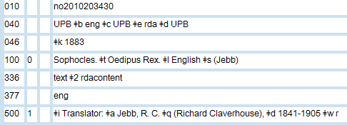
New field: 336: Content Type (R)
Notes:
76
LC is asking us to not supply at this time until PCC works out all the recommendations from the Access Points for Expressions Task Group

Slide 77
New field: 380: Form of Work (R)
No indicators
Subfields:
$a Form of work (R)
$0 Record control number (R)
$2 Source of term (NR)
RDA 6.3

Slide 78
New field: 380: Form of Work (R)
Only applicable to Work level NAR’s
No authorized vocabulary required
First letter of term capitalized
Describes class or genre of Work. May be used to differentiate from another Work with the same title
e.g. Play, Novel, Essay, Conference proceedings, Board book, etc.
Notes:
78
This a place where using LCGF terms might be eventually recommended. However, there is not authorized vocabulary at this time.
Prefer broader terms.

Slide 79
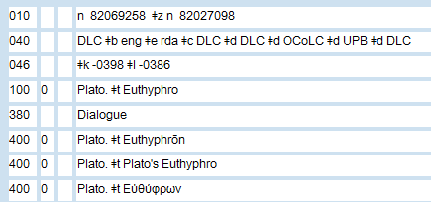
New field: 380: Form of Work (R)
Notes:
79

Slide 80
New field: 381: Other Distinguishing Characteristic (R)
No indicators
Subfields:
$a Other distinguishing characteristic (R)
$u Uniform Resource Identifier (R)
$v Source of information (R)
$0 Record control number (R)
$2 Source of term (NR)
RDA 6.6, 6.12

Slide 81
New field: 381: Other Distinguishing Characteristic (R)
Only applicable to Work or Expression NAR’s
Any defining characteristic other than those already existing as attributes
Date, Language, or Content Type already exist, so:
e.g. Edition, version, publisher name, translator name, arranged statement of music, etc.
Capitalize first letter if appropriate

Slide 82
MARC21 in NACO RDA Authority Records
Music

Slide 83
New field: 382: Medium of Performance (R)
No indicators
Subfields:
$a Medium of performance (R)
$0 Record control number (R)
$2 Source of term (NR)
RDA 6.15

Slide 84
New Field: 383: Numeric Designation of Music Work
No indicators
Subfields:
$a Serial number (R)
$b Opus number (R)
$c Thematic index number (R)
$d Thematic index code (NR)
$e Publisher associated with opus number (NR)
$2 Source (NR)
RDA 6.16
Notes:
84

Slide 85
New field: 384: Key (R)
1st Indicator indicates original (0) or transposed (1) key, or unknown (_)
Subfields:
$a Key (NR)
RDA 6.17

Slide 86
New field: 384: Key (R)
Work level attribute
Spell out major or minor; use ♯ or ♭for sharp or flat
Notes:
86

Slide 87
LC Training for RDA: Resource Description & Access
Part 4: RDA Toolkit

Slide 88
FRBR/FRAD → RDA organization
Remember that the organization of RDA is based on the organization of the FRBR models and tasks, which includes FRAD
Entities: Persons, Corporate Bodies, Families
Each entity has attributes
Person has Name, date, gender, etc.
Attributes are to serve the user tasks of:
Find, Identify, Contextualize, and Justify
Notes:
Section 3 of RDA (the best section) has most of the information we need. We will also need to refer to Section 2 when doing authority work for Works and Expressions.
RDA Chapter 8 contains general guidelines
Chapters 9-11 go into specific detail about each of the entity attributes and then tell you how to construct the authorized access point (Use Chapter 9 as an example)

Slide 89
FRBR/FRAD → RDA organization
A Work, Expression, etc., can be represented by an authority record
e.g. establishing an authorized access point for a translation is an Expression NAR
e.g. establishing an authorized access point for the story of Cinderella is a Work NAR
Notes:
Just a reminder that that RDA doesn’t have a separate “section” for authorized headings as opposed to descriptive cataloging.
The same rules that establish what you put in a title proper in the bibliographic record are what tell you what to record in an authority record.
RDA says nothing about where to record information, only what information needs to be recorded and how you put it together for an authorized (or variant) access point.

Slide 90
General Guidelines
RDA Chapter 8
Purpose and definitions
Generalities:
Capitalization, numerals as words, punctuation, initials, acronyms, etc.
Undifferentiated name category
Status of identification
Notes:
Chapter 8 also contains the FRAD user tasks. Remember that you are a user of these data so these tasks apply to you as well.

Slide 91
Personal Names
Look at RDA Chapter 9 for Personal Names
Element list
Authorized access point instruction
Variant access point instruction

Slide 92
Family Names
RDA Chapter 10 for Family names
Same pattern of Element list
Followed by how to construct authorized access point
And variant access point
Notes:
Note that the authorized access point doesn’t use all the pieces of information collected in the record.
Some of them are collected for user tasks but don’t necessarily contribute to the formation of the heading.
What we are recording here does not serve JUST the creation the authorized access point.

Slide 93
Corporate Bodies
Last in the Group 2 entities is RDA Chapter 11 for Corporate Bodies
Entry element decisions of parent/subordinate entry still exists: see RDA 11.2.2.13-31
Under the choice of preferred name
List of elements, followed by authorized access point construction, same as before
Notes:
This still includes events, such as conferences and exhibitions, etc.

Slide 94
Geographic Names
Important: Geographic Names are a Group 3 entity, and therefore are also a part of FRSAD, as well as FRBR and FRAD
That information is found in RDA Chapter 16, part of the Group 3 entities section
Those instructions apply only to Geographic Names used as jurisdictions at this time, not general geographic features such as mountain ranges

Slide 95
Works, Expressions, etc.
FRBR Group 1 entities, so use RDA Chapter 6 for Works and Expressions
Record enough information, as allowed by the MARC 21 guidelines
Do NOT recreate the bib record
Forming the authorized access point for FRBR Works and Expressions is in RDA 6.27

Slide 96
RDA ≠AACR2
While many of the actual rules will be the same, the underlying structure is different
Don’t look for the descriptive cataloging vs. authority heading and cross-references division of AACR2 in RDA
All entities are equal

Slide 97
LC Training for RDA: Resource Description & Access
Part 5: Identifying Persons

Slide 98
Vocabulary
Name: Word, character, or group of words and/or characters by which a person is known
Preferred Name: Form to be used when constructing the authorized access point in bibliographic records and 1XX field of name authority records
Variant Name: Form used in variant access points (4XX fields in name authority records)
Notes:
Do not say headings anymore!

Slide 99
Vocabulary
Access Point: Name, term, code, etc., representing a specific person
Authorized Access Point: Standardized access point representing an entity; uses the preferred name for the person
Variant Access Point: Alternative to the authorized access point representing an entity; constructed using a variant name for that person

Slide 100
General Guidelines
Language and Script
“Record names in the language and script in which they appear on the sources from which they are taken.”
Alternative: Record a transliterated form of the name either as a substitute for, or in addition to, the form that appears on the source.
Record other identifying attributes of a person, family, or corporate body in the language and script prescribed in the applicable instructions in chapters 9-11.
Notes:
PCC libraries will continue to give names of those entities in the Latin script in the authorized access points in authority records and in bibliographic records.
PCC libraries may also continue the current policy for some languages to give variant access points (MARC 4XX fields) in the original language/script in authority records.
Then– for those “other identifying attributes”– if instructions in Chapter 9 do not specify language, give the elements in English.

Slide 101
Scope of “Person”
“An individual or an identity established by an individual (either alone or in collaboration with one or more other individuals)”
An individual does not have to be a real person!
Yes, it’s true … in RDA Rocky, Bullwinkle, Natasha Fatale, and Boris Badenov are persons!

Slide 102
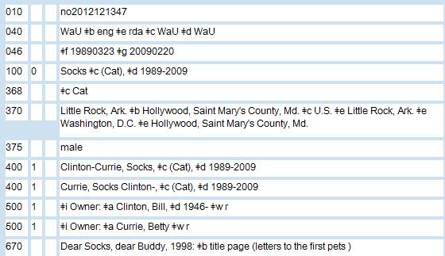
Real RDA Records for Persons

Slide 103
Identifying Persons
RDA Chapter 9 “Identifying Persons”
9.0 Purpose and Scope
9.1 General Guidelines on Identifying Persons
9.2 Name of the Person
9.3 Date Associated With the Person
9.4 Title of the Person
9.5 Fuller Form of Name
Notes:
At the end of the chapter, there is an instruction that says which of those elements to use in constructing an authorized access point.
For persons, the preferred name is the basis for the authorized access point.
There are five possible additions to the preferred name with a prescribed order in RDA; in the instruction for each of those elements, there is a link back to the element itself for guidance on how to construct the element.

Slide 104
Identifying Persons
RDA Chapter 9 “Identifying Persons”
9.6 Other Designation Associated with the Person
9.7 Gender
9.8 Place of Birth
9.9 Place of Death
9.10 Country Associated with the Person

Slide 105
Identifying Persons
RDA Chapter 9 “Identifying Persons”
9.11 Place of Residence
9.12 Address of the Person
9.13 Affiliation
9.14 Language of the Person
9.15 Field of Activity of the Person
9.16 Profession or Occupation

Slide 106
Identifying Persons
RDA Chapter 9 “Identifying Persons”
9.17 Biographical Information
9.18 Identifier for the Person
9.19.1-9.19.2.1 Constructing Access Points to Represent Persons

Slide 107
Preferred Name (RDA 9.2.2)
Choose the form most commonly known
Surnames: words, etc., indicating relationships (e.g., Jr., IV) part of the preferred name -- not just to differentiate
Example: Davis, Sammy, Jr.
Notes:
The emphasis is on the most-commonly-known form as the preferred name for a person.
Words including relationships can be part of the preferred name if such a word, etc., is part of the commonly-known form.
If there are variant spellings of the person’s name, use the form found on the first resource received.

Slide 108
Preferred Name (RDA 9.2.2)
Different names for the same person (RDA 9.2.2.6) and change of name (RDA 9.2.2.7)
If individual has more than one identity, a preferred name for each identity (RDA 9.2.2.8)
No time period restrictions
Different categories of names: RDA 9.2.2.9-RDA 9.2.2.26
Notes:
Listed here are the categories of instructions for preferred names for persons. Don’t panic– most of this is similar to AACR2.
For example, RDA 9.2.2.6 and RDA 9.2.2.7: for different names of the same person, order of preference:
a) the name that appears most frequently in resources associated with the person;
b) the name that appears most frequently in reference sources;
c) the latest name.
For name changes, “choose the latest name or form of name as the preferred name.” You already know this from AACR2.
If the person has more than one identity, there are no longer any time period restrictions on establishing separate access points for each identity. So that old LCRI about the differences between contemporary persons and non-contemporary persons when dealing with pseudonyms is gone– good news!
Now, for the instructions in RDA 9.2.2.9-9.2.2.26, we are not going to take the time to look at these in detail. But do not panic– although you do need to look at these in RDA, you will not find a lot of differences between what you read and what you already know from AACR2. Please do take the time to read through RDA though– do not take anything for granted. It is too easy to become complacent.

Slide 109
Changes in Preferred Names
Terms of address only if part of the preferred name -- not as additions:
Name consists only of the surname (RDA 9.2.2.9.3: Seuss, Dr.)
Married person identified only by a partner’s name and a term of address (RDA 9.2.2.9.4: Davis, Maxwell, Mrs.)
Part of a phrase consisting of a forename(s) preceded by a term of address (RDA 9.2.2.23: Sam, Cousin)
Notes:
Here is a change from AACR2, but in philosophy only, because when we go to create the access point using MARC 21, the preferred name will end up looking the same– with a subfield $c. So, again, nothing really new for you to note. Remember, in AACR2, these terms of address were considered additions to the name, not a part of it.

Slide 110
Additions to the Preferred Name
Title of the person (RDA 9.4):
Royalty, nobility, or ecclesiastical rank or office
Person of religious vocation
Other designation associated with the person (RDA 9.6):
Christian saints
Spirits
Notes:
Now we are back to similarities in AACR2– in RDA and in AACR2, titles and other designations are considered additions to the preferred name, not a part of it.

Slide 111
Date Associated with the Person (RDA 9.3)
An addition to the preferred name
Date of birth (RDA 9.3.2) -- if available
Date of death (RDA 9.3.3) -- if available
Period of activity of the person – no restrictions on time period in RDA (RDA 9.3.4) -- cataloger judgment if needed to differentiate
Guidelines for probable dates (RDA 9.3.1)

Slide 112
Dates: What’s New and Different?
Abbreviations “cent.,” “ca.,” “b.,” “d.,” and “fl.” not in RDA Appendix B
“cent.” becomes “century”
“approximately” replaces “ca.”
“b.” and “d.” dates: LC is using hyphens instead of spelling out the abbreviations
“fl.”: LC is using “active”
Notes:
Important to note: LC has a policy in LCPS 9.3.3.3 for using hyphens instead of “born” and “died” and in LCPS 9.3.4.3 to use active in place of fl. or flourished.
No date restriction on the hyphen. You can make an access point like: Smith, John, 1750-

Slide 113
Fuller Form of Name (RDA 9.5)
Scope:
Full form of a part of a name represented only by an initial or abbreviation in the form chosen as the preferred name, or
A part of the name not included in the form chosen as the preferred name (change from AACR2)
Notes:
The scope of this LC core element has been expanded in RDA to include a part of the name not included in the form chosen as the preferred name, like unused middle names.
For the most part, we only care about the first bullet.

Slide 114
Occupation (RDA 9.16) Field of Activity (RDA 9.15)
Core:
If name does not convey the idea of a person
LC policy: cataloger judgment choice to distinguish one person from another with the same name
MARC 21 X00 $c – always in parentheses:
100 1 $a Cavaliere, Alfonso $c (Physicist)
Notes:
Code in MARC subfield $c and always be enclose in parentheses.
This is different from the AACR2 practice of using different punctuation depending on the type of name (given name, etc., vs. surname, etc.).

Slide 115
Those New Fields in the MARC 21 Authority Format for Persons
046: Special coded dates (RDA 9.3)
370: Associated place (RDA 9.8-9.11) (not in 1xx)
371: Address (RDA 9.12) (not in 1xx)
372: Field of activity (RDA 9.15) (not in 1xx)
373: Associated group (RDA 9.13) (not in 1xx)
374: Occupation (RDA 9.16)
Notes:
You saw these fields earlier in the presentation, so we will not be going over them again.
Some of these attributes may be used in the authorized access point for the person, generally to break a conflict, but sometimes they are added to the AAP even when there is no conflict.
Where you see (not in 1xx) on the slide, that means that the attribute may not be used in the 1xx, but when available, and generally according to cataloger’s judgment, it certainly may be added to the authority record!

Slide 116
Those New Fields in the MARC 21 Authority Format for Persons
375: Gender (RDA 9.7) (not in 1xx)
377: Associated language (RDA 9.14) (not in 1xx)
378: Fuller form of personal name (RDA 9.5)
Notes:
Cataloger’s judgment as to add the fuller form to the AAP or not. Not compulsory.

Slide 117
Elements Not Eligible for Inclusion in Authorized Access Points
May be helpful for identification:
Associated place (RDA 9.8-9.11)
Address (RDA 9.12)
Affiliation (RDA 9.13)
Gender (RDA 9.7)
Language of the person (RDA 9.14)
Field of activity (RDA 9.15)
Biographical information (RDA 9.17)
Notes:
You might be asking yourself, why is it important to add this information if it cannot be used in the authorized access point.
Remember: the one of the principles of RDA and FRAD is that we are creating a unique identity for the person, and not simply a unique access point.
We are getting our data ready for a future where it can be used and displayed in myriad ways.

Slide 118
Wrap-Up
RDA allows you to create a unique description of a person by recording attributes about that person in an authority record
The authorized access point for the person is just a part of that unique identifier
An RDA NAR is much more dynamic than an AACR2 NAR!

Slide 119
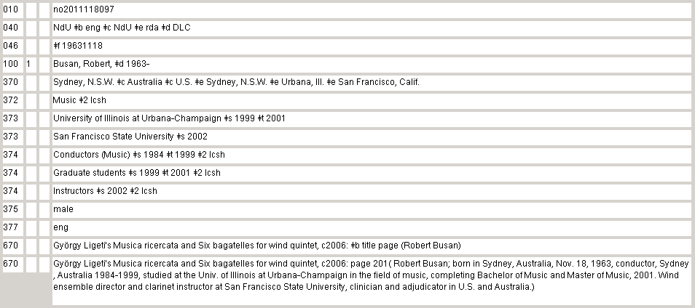
Wrap-Up
Notes:
Here is an example of an RDA NAR in OCLC.
You can see some of the attributes we have just described illustrated in the NAR.
Think about how much more dynamic this RDA NAR can be in an online environment– it is a living thing.

Slide 120
More Information the New MARC 21 Authority Format Fields
http://www.loc.gov/aba/pcc/rda/PCC%20RDA%20guidelines/RDA%20in%20NARs-SARs_PCC.doc

Slide 121
Constructing Authorized Access Points
121
Notes:
121
It is not until RDA 9.19, at the end of the chapter, that we finally arrive at the instructions for creating the authorized access point, the 1xx.
We will rely on all the previous sections of Chapter 9 to assist us in the construction of the access point, however.

Slide 122
Authorized Access Points for Persons (RDA 9.19)
RDA 9.19.1.1: how to put together the elements to construct an authorized point [with links back to specific elements]
Preferred name is the basis
Additions to the name as instructed under 9.19.1.2–9.19.1.6 – the Big Five!
LC policy change for additions and order: date(s) of birth and/or death if available; if still need to differentiate, then cataloger judgment on choice
122
Notes:
122
In chapter 9 the elements identifying a person are given separately at the beginning of the chapter. Then, at the end of the chapter, there is an instruction that says which of those elements to use in constructing an authorized access point.
For persons, the preferred name is the basis for the authorized access point. There are five possible additions to the preferred name with a prescribed order in RDA; in the instruction for each of those elements, there is a link back to the element itself for guidance on how to construct the element.
If the date of birth and/or death is available when establishing the authorized access point, include those dates; if another characteristic is needed to differentiate the access point for one person from the access point for another (either because dates of birth/death were not available or because there is still a conflict), apply cataloger judgment in the choice of the other attribute to add. You do not need to follow the priority order given in RDA 9.19.1.1.

Slide 123
Additions to the Preferred Name
9.19.1.2 (9.4 and 9.6): Title or other designation associated with the person
Required for certain names
9.19.1.3 (9.3.2/9.3.3): Date of birth and/or death
Give if available
9.19.1.4 (9.5): Fuller form of name
Add if useful for identification
123
Notes:
123
Again, cataloger’s judgment on the fuller form when there is no conflict

Slide 124
Additions to the Preferred Name
9.19.1.5 (9.3.4): Period of activity of person
Add to differentiate
9.19.1.6 (9.16): Profession or occupation
Required for certain names; Can add to differentiate
124
Notes:
124
2nd category id required if the name doesn’t convey the idea of a person

Slide 125
Putting the Authorized Access Point into MARC 21
No big surprises here!
Follow:
Punctuation as in AACR2 (RDA Chapter 8 & LCPS 1.7.1)
Capitalization as in AACR2 (RDA Appendix A & LCPS 1.7.1 )
MARC 21 tagging and coding as in AACR2
Entry elements as in AACR2
125
Notes:
125
Even though RDA is very close to AACR2 in terms of constructing an authorized access point for a person, still you cannot apply the instructions in RDA without reading and understanding them first.
The purpose of this module is to show you how to construct an RDA authorized access point for a person, and in order to do that, we are using comparisons between AACR2 and RDA to assist you.
Remember, though, there is no substitute for a thorough reading of RDA!
And we are not encouraging you to apply RDA based on these slides alone. It is your responsibility to use these slides as an entry to the RDA instructions.

Slide 126
RDA or AACR2?
126
Notes:
126
Just a short quiz at the end of this module. Which of these are RDA authorized access points and which are AACR2 headings. Some of them may be both! Don’t worry– we will look at the AACR2/RDA similarities and differences in more depth in Module 4.d.
Answers:
Both
Both
RDA
RDA
AACR2
RDA

Slide 127
Constructing Variant Access Points
Additions to the authorized access point are generally included in the variant access point
127
Notes:
127
RDA gives us instructions on variant access points for a person in 9.19.2– right after section on Constructing Authorized Access Points– in fact, 9.19.2 is a sub-section of 9.19—Constructing Access Points to Represent Persons.
So, whereas in AACR2 you would have gone to Chapter 26 to find out about variants, in RDA, you stay in the same chapter.
What is the same between AACR2 and RDA is this: you construct a variant access point as if it were an authorized access point– treat the variant as if it were an authorized access point, meaning that any or all additions that would be allowed in the authorized access point are appropriate in the variant access point.

Slide 128
Variant Access Points
Which variants do you include in an authority record as 4XX fields?
RDA 9.2: CORE ELEMENT
Preferred name for the person is a core element. Variant names for the person are optional.
LC policy: cataloger judgment
Consider what users (remember FRAD User Tasks!) would need or find helpful
128
Notes:
128
RDA does not require any categories of variant access points. It is all cataloger’s judgment.
Consider what users would need to find the authorized access point form.
This may be a hard concept to get your head around, especially if you have been doing AACR2 authority work for a long time. Primary elements concept … gone, variant usages identified … gone. This is now cataloger’s judgment, not rule-determined.
The PCC is currently recommending certain categories of variants that may be considered either policy to add or “best practice” so we might get some more guidance at some point.

Slide 129
RDA and AACR2
Conceptually different codes
Authority work under each code has many similarities, though
But there are some major differences
Nothing can beat a thorough reading and understanding of RDA!
129
Notes:
129

Slide 130
RDA and AACR2: Similarities
MARC 21 coding and field order
Unique headings (AACR2) / Unique access points (RDA) concept
Yes, there are undifferentiated names in RDA– but fewer than in AACR2!
Additions to names (RDA 9.19.1.2-9.19.1.6)
But a couple of exceptions!
Data added to the authority record
But in different locations!
130
Notes:
130
Nothing new to learn about MARC 21 except for the new fields that have been defined for the authority format– the 046, the 3xx, etc.
Just as in AACR2, you strive to make a heading unique.
Can still have undifferentiated names in RDA, however there are now more options to make an access point unique.
In AACR2 we added data to the 670 field of the authority record, and that data remained in the 670 for future use as a conflict breaker. Of course, some of the data in the 670 ended up in the heading from the start.
But– and this is a difference– in RDA, we add data in fields that can be manipulated by machine for purposes that the AACR2 670 would not allow. By packaging the data we add in RDA authority records in a way that makes those data come alive– we are opening ourselves to the promise of linked data and the realization of FRAD user tasks.

Slide 131
RDA and AACR2: Similarities
NACO Normalization (NACO)
Punctuation and Spacing (RDA Chapter 8, LCPS 1.7.1)
That means initials, capitalization, abbreviations, etc.
Choice of name (RDA 9.2.2)
Creators using more than one language (RDA 9.2.2.5.2)
Changes of name (RDA 9.2.2.7)
131
Notes:
131

Slide 132
RDA and AACR2: Similarities
Multiple bibliographic identities (RDA 9.2.2.8)
Entry elements (RDA 9.2.2.4)
Prefixes (RDA 9.2.2.11)
Dates added to authorized access point when available (RDA 9.19.1.3 + LCPS for LC)
132
Notes:
132

Slide 133
RDA and AACR2: Differences
Elements considered part of the name in RDA, and not additions to the name as in AACR2 (RDA 9.2.2.3)
No RDA “Compatible” access points like AACR2 Compatible headings
Preferred Source of Information – No Priority Order (RDA 2.2.2)
Use of subfield $w r $i Real identity in lieu of simple see also references (RDA Appendix K.2)
133
Notes:
133

Slide 134
RDA and AACR2: Differences
No difference in contemporary/non-contemporary persons
Jr., Sr., III, etc. now considered part of the name (RDA 9.2.2.9.5)
Use of “active” over “fl.” (RDA 9.3.4.3)
134
Notes:
134

Slide 135
RDA and AACR2: Differences
May add an occupation to an authorized access point to break a conflict (RDA 9.16.1.6)
Fictitious characters are now “persons” (RDA 9.0):
Poirot, Hercule
MARC 21 subfield $c used more consistently:
Butler, Jean $c (Composer)
[not: Butler, Jean, $c composer]
135
Notes:
135

Slide 136
Summary
Do not fear!
If you are a good AACR2 authorities cataloger, you will be a good RDA authorities cataloger
We stressed the differences here, but there are more similarities than you realize
Most of RDA Chapter 9 is lifted from AACR2 Chapter 22 with little change
136
Notes:
136

Slide 137
Acknowledgments
These presentation slides have been adapted from RDA training materials prepared by the Library of Congress Policy and Standards Division for RDA Refresher Training at the Library of Congress, October 2011

Slide 138
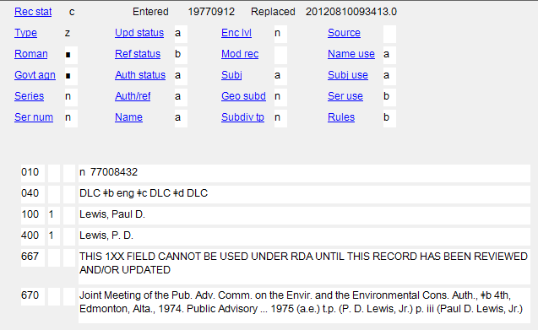
Exercise 1
How would this record be different under RDA?

Slide 139
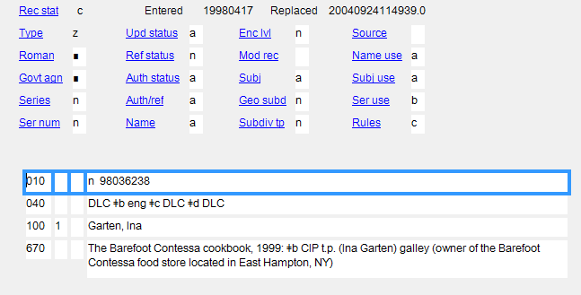
Exercise 2
How could we spruce up this record under RDA?

