Slide 1
RDA Module 1 Manifestation and Item Transcription Exercises

Slide 2
Transcribe into MARC Fields According to RDA

Slide 3
Transcription Answer Sheet
040 ǂe rda
245 14 THE STINKING ROSE RESTAURANT Cookbook / ǂc by Andrea Froncillo with Jennifer Jeffrey ; photography by Caren Alpert
245 14 The Stinking Rose Restaurant Cookbook / ǂc by Andrea Froncillo with Jennifer Jeffrey ; photography by Caren Alpert
264 _1 Berkeley : ǂb Ten Speed Press, ǂc [2006]
264 _1 Berkeley ; ǂa Toronto :ǂb Ten Speed Press, ǂc [2006]
264 _4 ǂc 2006

Slide 4
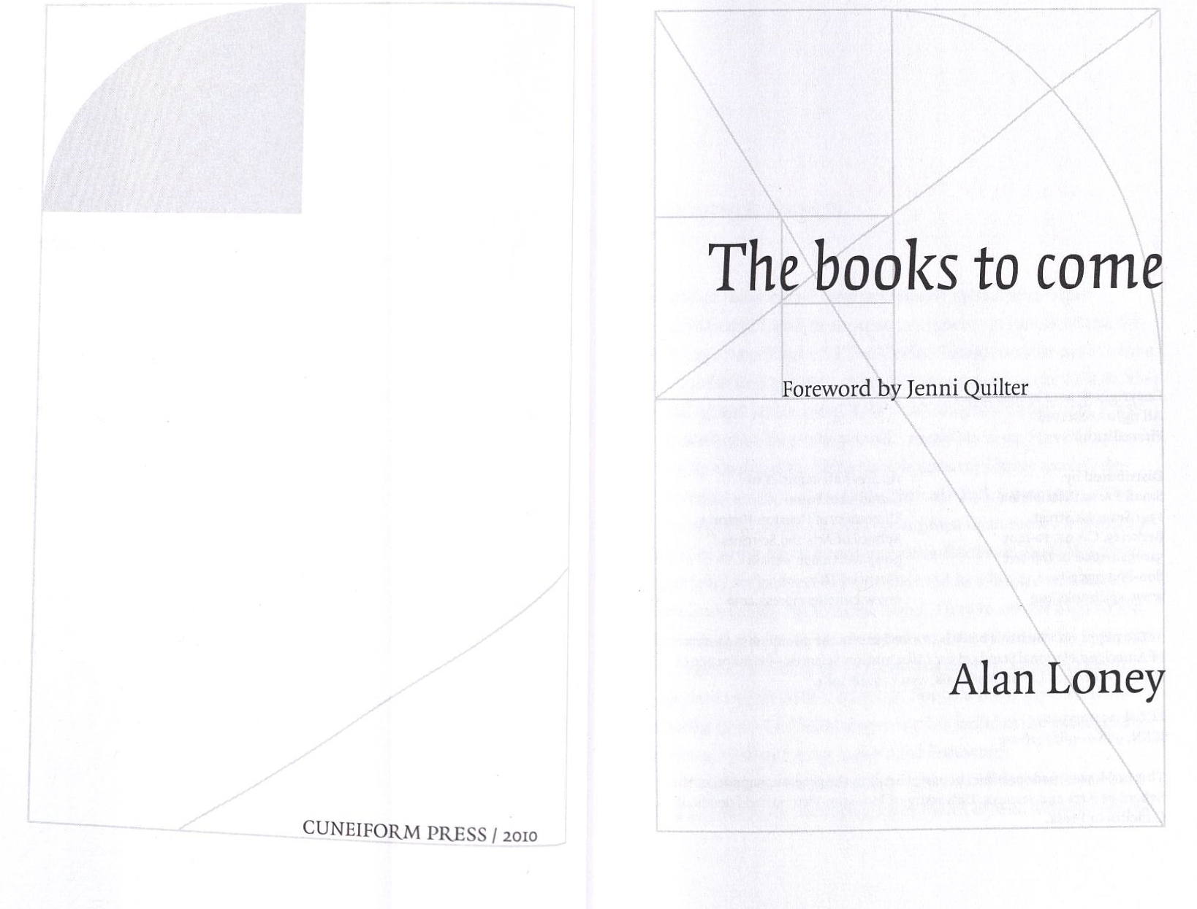
Transcribe into MARC Fields According to RDA

Slide 5
Transcription Answer Sheet
ǂe rda
245 14 The books to come / ǂc Alan Loney ; Foreword by Jenni Quilter.
264 _1 [Place of publication not identified] : ǂb Cuneiform Press, ǂc 2010.

Slide 6
Transcribe into MARC Fields According to RDA

Slide 7
Transcription Answer Sheet
040 ǂe rda
245 14 The books to come / ǂc Alan Loney ; Foreword by Jenni Quilter.
First edition
264 _1 Victoria, TX : ǂb Cuneiform Press, ǂc 2010.

Slide 8
Transcribe into MARC Fields According to RDA

Slide 9
If place of publication not in source, but with distribution info.
040 ǂe rda
245 14 The books to come / ǂc Alan Loney ; Foreword by Jenni Quilter.
250 First edition
264 _1 [Place of publication not identified] : ǂb Cuneiform Press, ǂc 2010.
264 _2 Berkeley, CA : ǂb Small Press Distribution.
LC’s recommendation:
264 _1 [Berkeley, CA]: ǂb Cuneiform Press, ǂc 2010.
But, BE CAREFUL!

Slide 10
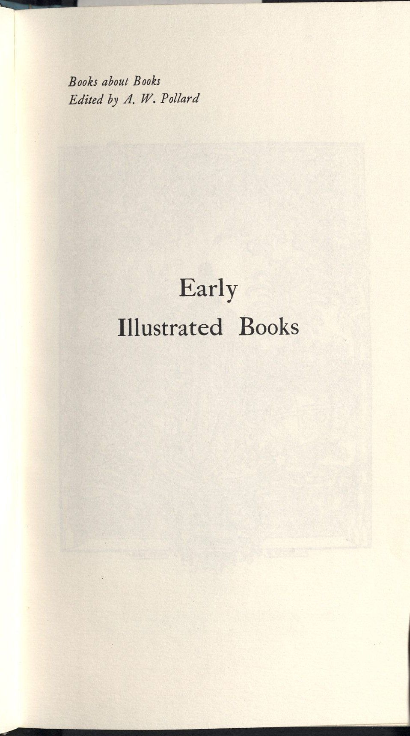
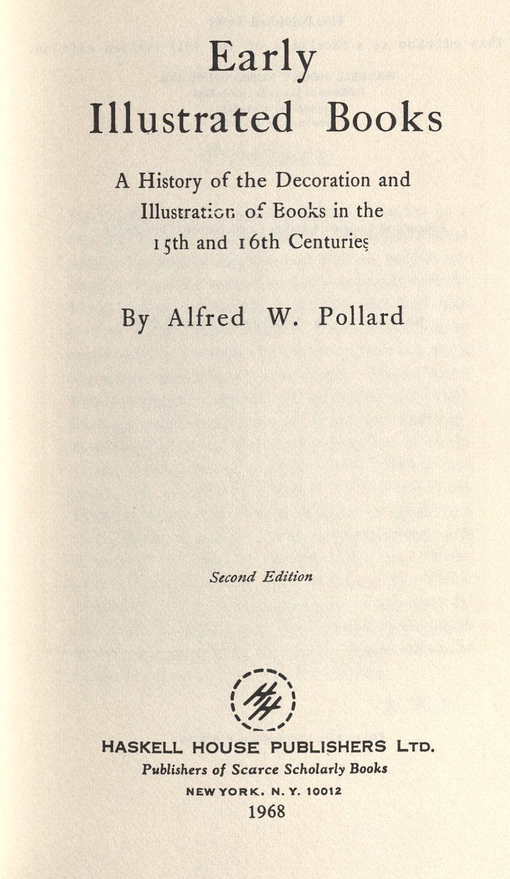
Transcribe into MARC Fields According to RDA

Slide 11
Transcription Answer Sheet
040 ǂe rda
2451_ Early Illustrated Book : ǂb A History of the Decoration and Illustration of Books in the 15th and 16th Centuries / ǂc By Alfred W. Pollard.
250 Second Edition
264_1 New York : ǂb Haskell House Publishers Ltd., c 1968.
490 0_ Books about Books

Slide 12
Transcribe into MARC Fields according to RDA Note: Special Collections catalogers, follow DCRM(B) rules for transcription

Slide 13
Transcription Answer Sheet
040 ǂe rda
245 1 4 The Great Wickedness And Mischievous Effects of Slandering : ǂb Represented in a SERMON PREACHED at St. GILES withouth Cripplegate, On Sunday Nov. 15, 1685 / ǂc By EDWARD FOWLER, D.D. ; Together with a Preface and Conclusion in his own VINDICATION.
040 ǂe rda ǂe dcrmb
245 14 The great wickedness, and mischievous effects of slandering : ǂb represented in a sermon preached at St. Giles without Cripplegate, on Sunday Nov. 15, 1685 / ǂc by Edward Fowler, D.D. ; together with a preface and conclusion in his own vindication.
250 __ The second impression
264 _1 London : ǂb Printed for Brabazon Aylmer, at the Three Pidgeons against the Royal-Exchange in Cornhill, ǂc 1685.

Slide 14
Transcribe into MARC Fields according to RDA Note: Special Collections catalogers, follow DCRM(B) rules for transcription

Slide 15
Transcription Answer Sheet
040 ǂe rda
245 10 Mr. Culpepper’s TREATISE OF Aurum Potabile : ǂb BEING A Description of the Three-fold WORD, Viz. Elementary, Celestial, Intellectual : CONTAINING The Knowledge necessary to the Study OF Hermetick Philosophy / ǂc Faithfully written by him in his Life-time and since his Death, published by his Wife.
040 ǂe rda ǂe dcrmb
245 10 Mr. Culpepper’s treatise of aurum potabile : ǂb being a description of the three-fold world, viz. elementary, celestial, intellectual : containing the knowledge necessary to the study of hermetick philosophy / ǂc faithfully written by him in his life-time, and since his death, published by his wife.
246 30 Treatise of aurum potabile
264 _1 [England?] : ǂb His wife, ǂc [1657?]
264 _3 London : ǂb Printed for George Eversden, at the Mayden-head in St. Paul’s-Church yard, ǂc 1657.

